Slide 1


Anusha Sundaram 14/March/2024

Slide 2

Columbia Asia: A Leading Multinational Healthcare Chain in Southeast Asia
Columbia Asia is a multinational chain of hospitals and one of the largest and fastest-growing healthcare companies in Southeast Asia. Columbia Asia started its operations in 1996, with the first hospital acquired a year later in Sarawak, East Malaysia. Currently, it has 22 medical facilities across Southeast Asia: 14 in Malaysia, 3 in Vietnam, and 5 in Indonesia.

Slide 3

Problem Statement
The healthcare industry continuously strives to understand patient demographics and their healthcare utilization patterns to optimize services and improve patient outcomes.
This presentation focuses on analyzing department referrals, physician billing patterns, Satisfaction score and revenue generated for 2019 & 2020.
Let us also see in detail regarding patient’s age group, visits w.r.t to AM/PM, Wait time etc.

Slide 4

Data Cleaning
Inconsistent Date Format: The date format in the dataset was inconsistent, with some dates in "dd-mm-yyyy" format and others in "mm-dd-yyyy" format. To ensure consistency for easier processing and analysis, all dates were converted to the "dd-mmmm-yyyy" format.
Patient Gender Representation: Instead of using abbreviations like "M" for male, "F" for female, and "NC" for non-binary or other gender identities, providing full forms such as "Male," "Female," and "Non-Confirming" avoids potential confusion and ensures clarity in the dataset.
Combining Patient First Initial and Last Name: The dataset contained separate columns for Patient First Initial and Patient Last Name. To simplify and consolidate the patient name information, these two columns were combined into a single column named "Patient Full Name". This consolidation facilitates easier reference and analysis of patient names.
Retention of Null Values in Patient Sat Score: Null values in the "Patient Sat Score" column were retained. Null values represent missing data and may contain valuable information for analysis or interpretation. Retaining null values ensures that no data is lost and allows for accurate representation of the dataset.

Slide 5
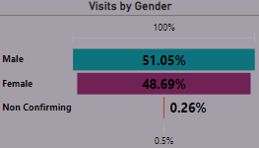
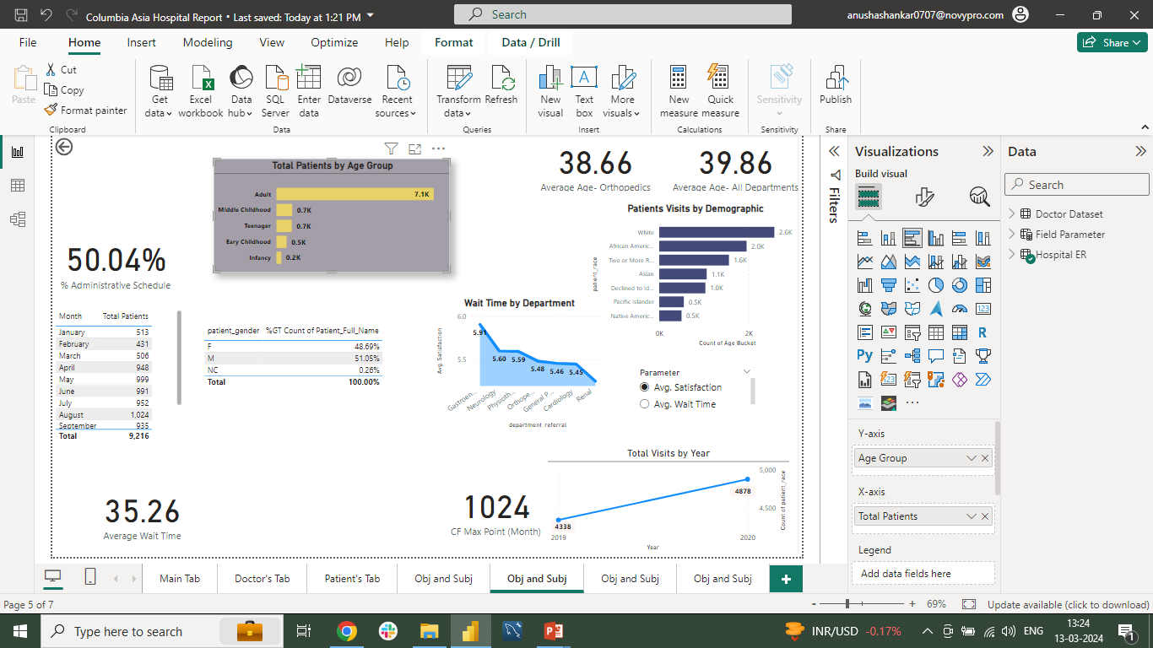
Understanding the Dataset
Gender Distribution: The dataset indicates a slight male predominance with 51.05% male, 48.69% female patients and 0.26% non-confirming.
Age Distribution: The age range varies widely, from infants to elderly individuals.
Racial Distribution: The patient population reflects diversity, encompassing various racial backgrounds.
General Practice: The majority of patients were referred to the General Practice department, indicating its importance as the primary point of contact for patients seeking healthcare services.
Orthopedics and Physiotherapy: While General Practice had the highest referral rate, Orthopedics and Physiotherapy also received significant patient referrals, highlighting the need for specialized care in these areas.

Slide 6
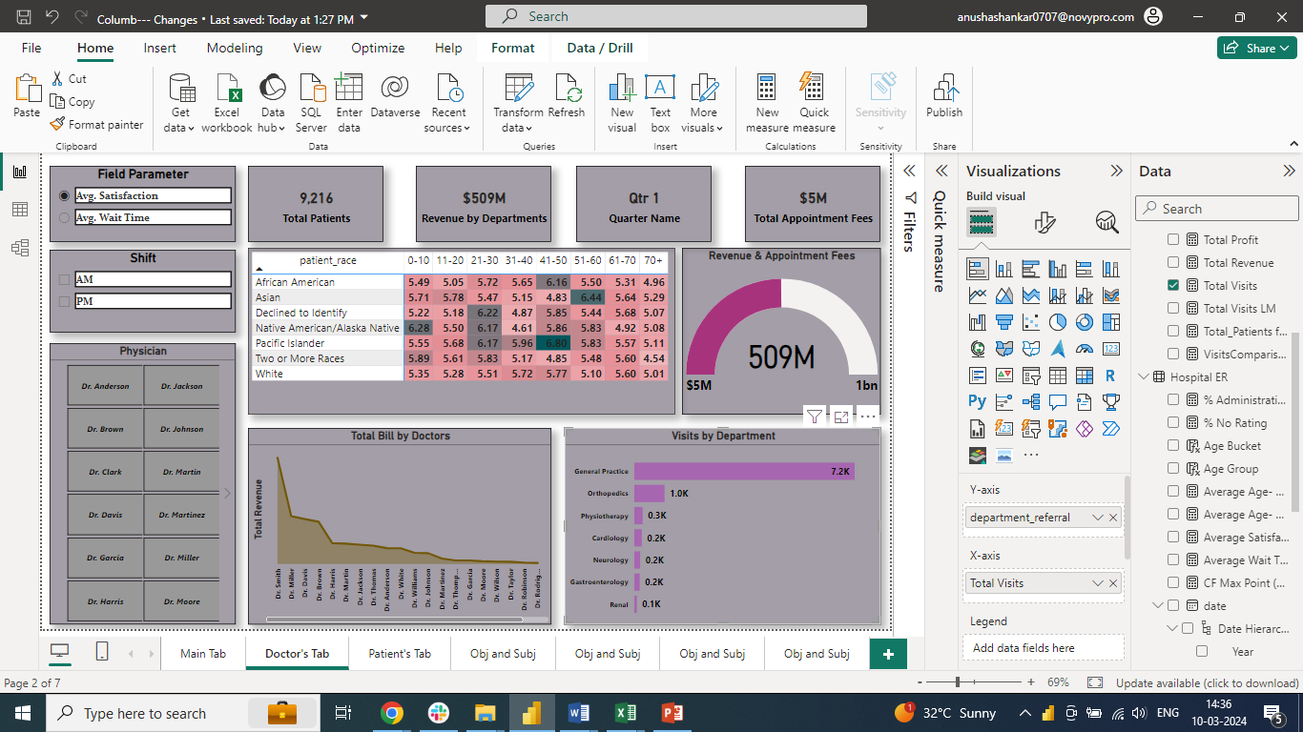
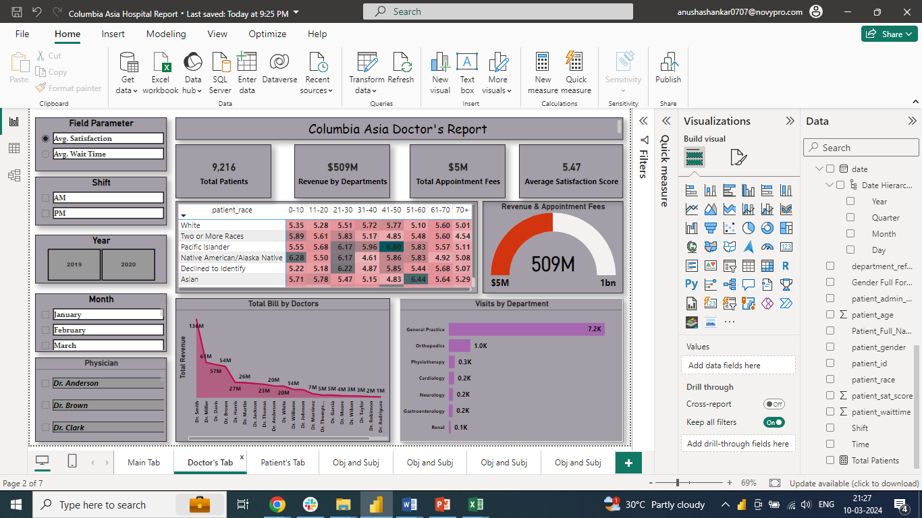
Healthcare Utilization and Physician Analysis
Patient Wait Time: On average, patients waited approximately 35.26 minutes before being attended to, with some variations across different departments.
Patient Satisfaction Scores: The majority of patients reported satisfactory experiences, with an average satisfaction score of 5.47 out of 10 as 75.10% didn’t rate the service.
Department Referral: The most frequently visited department was General Practice, followed by Orthopedics and Physiotherapy.
Dr. Smith: Among the physicians, Dr. Smith had the highest number of patient consultations across multiple departments, indicating his popularity and expertise in providing primary care services.
Dr. Miller, Dr.Davis and Dr. Brown: Other physicians, such as Dr. Miller, Dr.Davis and Dr. Brown, also had notable patient consultations, reflecting the diverse expertise available within the facility.

Slide 7

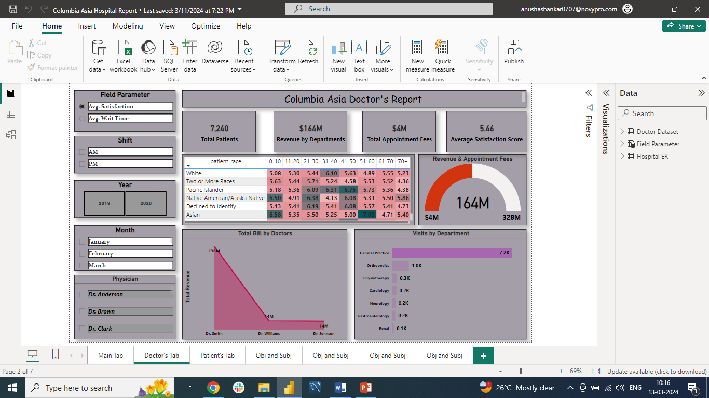
Financial Analysis
Appointment Fees: The appointment fee across all departments ranges from $500- $1500, reflecting the specialized nature of services provided.
Total Bill: The total bill varied across patients and departments, with “General Practice” consultations resulting in significantly higher bills of $4M as maximum patients visit this department.
Total Revenue: The total revenue of all departments is $509M. This can be calculated using Dax- “Total Revenue = SUM('Doctor Dataset'[Total Bill])”.

Slide 8

Key Findings
Demographic Diversity: The patient population demonstrates diversity across gender, age, and racial backgrounds, highlighting the importance of culturally sensitive healthcare practices.
Access to Care: While most patients received timely care, further analysis is required to identify factors contributing to variations in wait times across departments.
“General Practice” is the primary point of contact for patients, emphasizing the importance of primary care services in the healthcare facility.
“Dr. Smith” emerges as a prominent physician, demonstrating expertise and popularity among patients seeking primary care services.

Slide 9
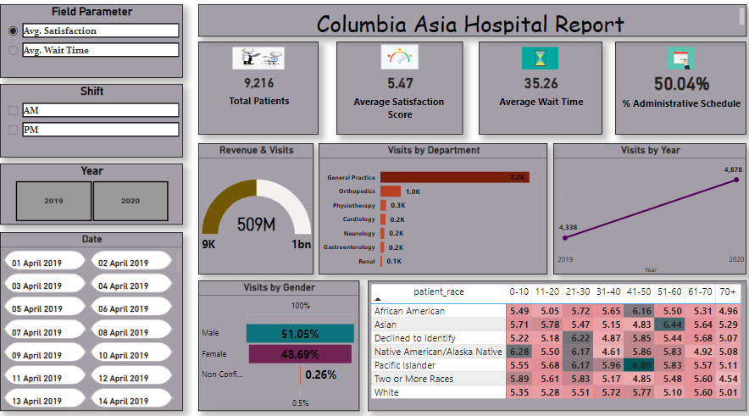

Slide 10

Recommendations
Continuous Monitoring: Regular monitoring of patient demographics and healthcare utilization patterns to identify trends and areas for improvement.
Quality Improvement Initiatives: Implementation of quality improvement initiatives to reduce wait times and enhance patient satisfaction.
Cultural Competency Training: Providing cultural competency training to healthcare staff to ensure the delivery of culturally sensitive care to all patients.

Slide 11

Conclusion
Understanding patient demographics, healthcare utilization patterns, physician billing trends is crucial for optimizing healthcare delivery and enhancing patient satisfaction.
Further research and analysis are warranted to identify areas for improvement and implement targeted interventions to meet the diverse needs of the patient population.

Slide 12
References
https://en.wikipedia.org/wiki/Columbia_Asia
https://blog.hubspot.com/marketing/blog/tabid/6307/bid/6012/17-examples-of-great-presentation-design.aspx

Slide 13

anushashankar0707@gmail.com

